Slide 1

SmartNews Al: Real-Time News and Personalized Chat Experience using NLP
Ansh Rathod 22107022
Ayush Sharma 22107028
Atharva Thube 22107062
Balkrishna Yadav 22107050
Project Guide
Ms. Harsha Zope

Slide 2
Outline
Introduction
Literature Survey of the existing systems
Limitations of the existing systems
Problem statement
System Design
Technologies and methodologies
Implementation
Conclusion
References

Slide 3
Introduction
In a world where news consumption is often overwhelming, Smart News enhances it with AI-powered summarization, interactive Q&A, real-time and historical updates.
For a seamless and personalized experience, Smart News also integrates:
  Weather forecasting.
  Multilingual translation services.
  Favourites and sharing.
  Category-based filtering on news.
  Voice-enabled news summarization, and Q&A.

Slide 4
Motivation
In today’s fast-paced world, staying informed is crucial, but lengthy articles and traditional news sources can be time-consuming and inefficient.
Many platforms lack AI-powered summarization, interactive Q&A, and translation, making news consumption harder.
Smart News simplifies this with AI-driven summaries, a chatbot, historical access, personalization, and multilingual support.
Our goal is to make news consumption faster, smarter, and more convenient for everyone.

Slide 5
Objectives
To provide AI-powered summarization, the system utilizes the BART model for generating concise and accurate news summaries.
To provide an interactive chatbot, the system leverages Gemini API for real-time Q&A and Google Text-to-Speech to deliver voice-based responses.
To search historical news, it integrates Sentence-BERT (all-MiniLM-L6-v2) for semantic embeddings and FAISS (Facebook AI Similarity Search) for fast retrieval using cosine similarity.
To provide real-time news by integrating a News API while enhancing accessibility with multilingual translation (Google Translate API) and weather forecasting (OpenWeatherMap API).

Slide 6
Literature Survey of the existing system
[1] Intelligent E-News Summarization (IEEE, 2018), Author: Varuni Alwis
Develops an extractive multi-document summarization system using graph-based (TextRank) and feature-based approaches for concise news summaries.
Key Technologies:
  NLP: Text processing.
  Summarization: TextRank (graph-based) & feature-based ranking
  Semantic Analysis: Word2Vec & WordNet for redundancy removal
  Libraries: NLTK, Gensim, Scikit-learn, NetworkX
Methodologies:
  Sentence Ranking: PageRank & feature-based scoring
  Redundancy Removal: Eliminates duplicate content
  Evaluation: ROUGE-1 for summary comparison
Smart News Website uses Extractive Summarization (NLP) for AI-powered summarization and an interactive chatbot for real-time Q&A.

Slide 7
Literature Survey of the existing system
[2] Efficient & Intelligent Weather Forecasting App (IOS Press, 2023), Authors:Gaurav Kumar Bharti, Abhijeet Ranjan, Anshul Bharat, Suraj Yadav
A web-based system providing real-time weather updates via OpenWeatherMap API, designed for hilly & forest areas where accurate forecasts are crucial.
Technologies:
  UI Design: HTML, CSS, JavaScript
  Weather Data: OpenWeatherMap API
  Geolocation: Precise weather updates
  Responsive Design: Works across devices
Methodologies:
  Real-Time API Data Fetching
  User-Friendly Interface (No Login Required)
Smart News Website integrates real-time weather updates and news summaries, enhancing the user experience by enabling weather checks while reading news.

Slide 8
Literature Survey of the existing system
[3] Automatic Text Summarization of News Articles (IEEE, 2017)
Authors: Prakhar Sethi, Sameer Sonawane, Saumitra Khanwalker, R. B. Keskar.
Develops an extractive text summarization system using lexical chains and WordNet to improve coherence and accuracy in news summaries.
Key Technologies:
  NLP: Sentence segmentation, POS tagging, lexical chains
  Summarization: Feature-based selection (sentence position, noun frequency)
  Pronoun Resolution: Enhances clarity using Stanford CoreNLP
  Libraries: NLTK, WordNet, Scikit-learn
Methodologies:
  Sentence Ranking: Lexical chain strength & noun importance
  Summary Extraction: High-scoring sentence selection
Smart News Website uses Extractive Summarization (NLP) for AI-powered summarization and an interactive chatbot for real-time Q&A.

Slide 9
Limitations of existing systems
Existing news systems have certain limitations, including:
Lack of AI-Powered Summarization - Users must read lengthy articles without a quick summary.
No Interactive Q&A - Existing platforms do not allow users to ask questions based on news content.
Limited Personalization - Most systems do not offer features like favorites, categorized filtering, Voice-enabled news reading, summarization, and Q&A or multilingual support.

Slide 10
Problem statement
Problem Statement:
  Most of the existing news platforms lack AI-powered summarization, interactive Q&A, and multilingual support, making it difficult for users to quickly understand and engage with news content efficiently.
Solution:
  Smart News solves these challenges with AI-driven summarization, a real-time Q&A chatbot, and multilingual translation for a seamless, personalized experience.
  It provides real-time and historical news, along with live weather updates, for an enhanced user experience.

Slide 11
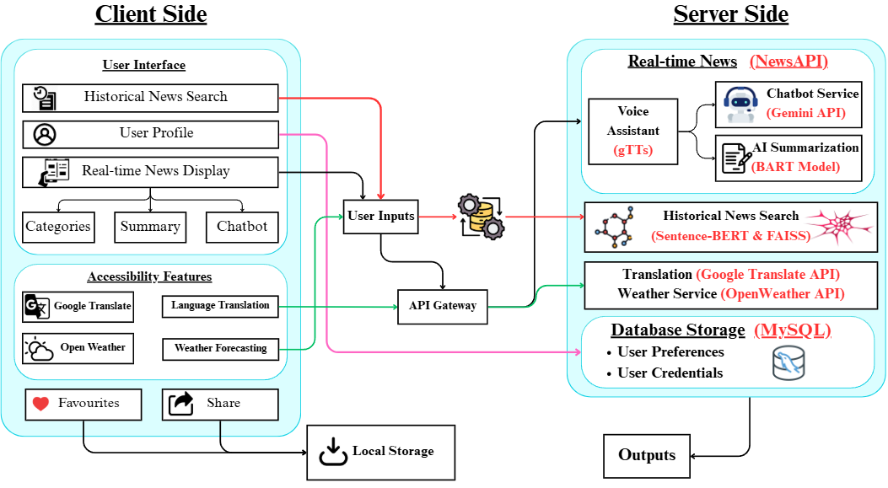
System Design

Slide 12
Technologies and methodologies
Algorithm:
Sentence-BERT (all-MiniLM-L6-v2)
FAISS (Facebook AI Similarity Search)
Google Text-to-Speech
BART model
Web Technologies:
Backend: MySQL, Flask.
Frontend: HTML, CSS, JavaScript.
Datasets Used:
Historical News Dataset
  Deerfieldgreen/sdk-historical-news: (3,40,088x7).
  [https://huggingface.co/datasets/deerfieldgreen/stk-historical-news?row=33].

Slide 13
Technologies and methodologies
Kaggle Datasets
  data.csv, rating.csv and raw-data.csv
  [https://www.kaggle.com/datasets/everydaycodings/global-news-dataset?]
  news_v1.csv
  [https://www.kaggle.com/datasets/azraimohamad/news-article-weekly-updated]
Application Programming Interface (API):
  1. News API.
  [https://newsapi.org/].
  2. OpenWeatherMap API.
  [https://openweathermap.org/api].
  3. Gemini API.
  [https://aistudio.google.com/apikey]

Slide 14
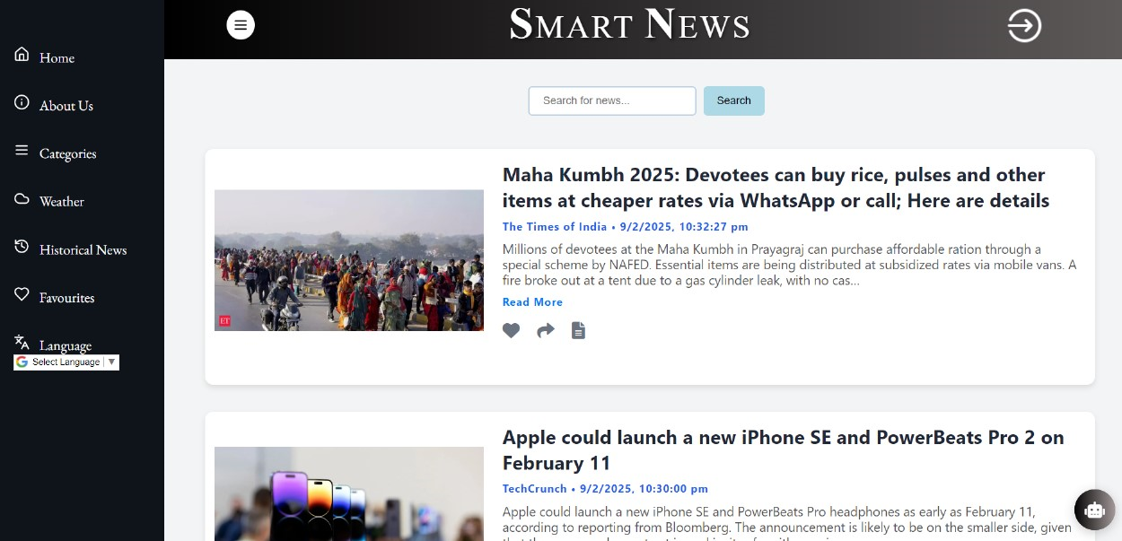
Implementation
Figure 1.1 Dashboard

Slide 15
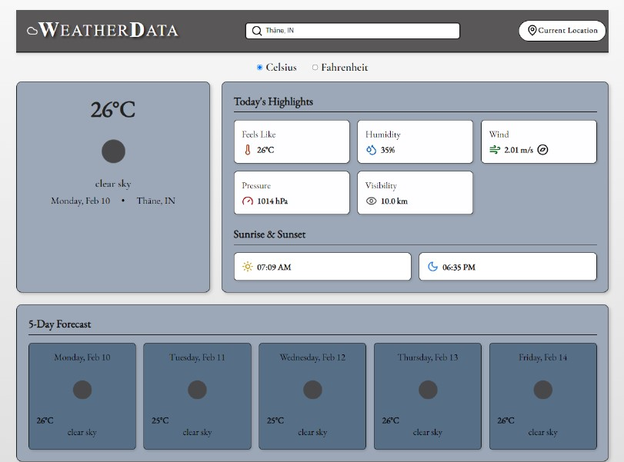
Implementation
Figure 1.2 Weather Forecasting

Slide 16
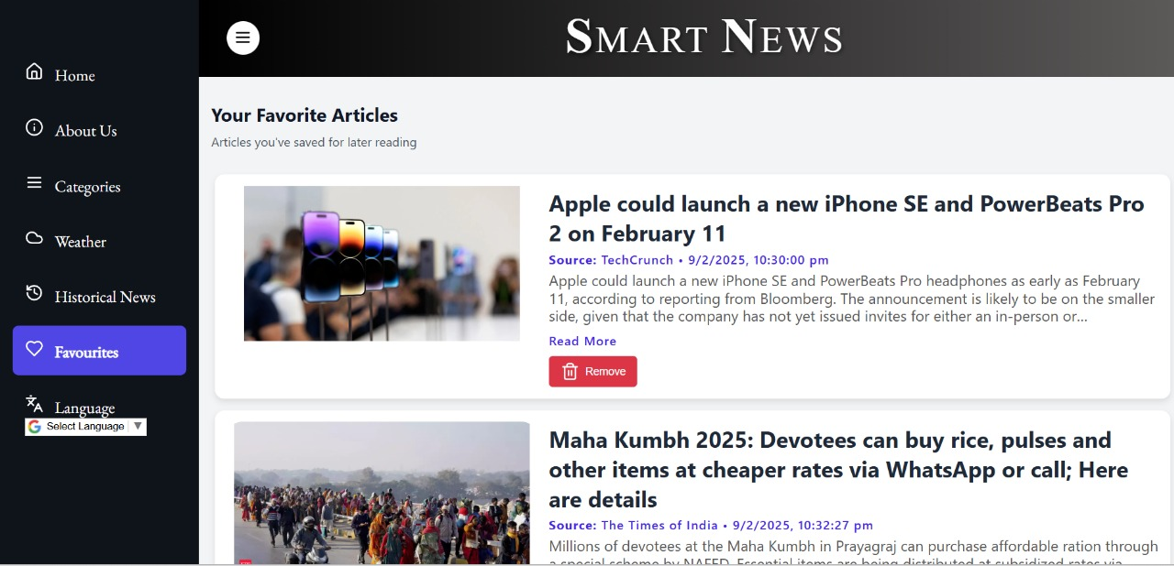
Implementation
Figure 1.3 Favorites Section

Slide 17
Conclusion
Smart News revolutionizes news consumption with AI-driven summarization, interactive Q&A, historical news access, and weather forecasting, ensuring a seamless and personalized experience.
By integrating real-time updates, multilingual support, and user-friendly features, it enhances accessibility and engagement for all users.

Slide 18
References
[1] V. Alwis, "Intelligent E-news Summarization" 2018 18th International Conference on Advances in ICT for Emerging Regions, (ICTer) Colombo, Sri Lanka, 2018.
[https://ieeexplore.ieee.org/document/8615590].
[2] G. Bharti, A. Ranjan, A. Bharat, and S. Yadav, "Design and Development of an Efficient and Intelligent Weather Forecasting App" (IOS Press) Punjab, India, 2023.
[https://www.researchgate.net/publication/367071091_Design_and_Development_of_an_Efficient_and_Intelligent_Weather_Forecasting_App]
[3] P. Sethi, S. Sonawane, S. Khanwalker, and R. B. Keskar, "Automatic Text Summarization of News Articles," 2017 International Conference on Big Data, IoT and Data Science (BID), Pune, India, 2017. [https://ieeexplore.ieee.org/document/8336568].

Slide 19
Thank You...!!

